Slide 1



Niagara: Scheduling DNN Inference Services on Heterogeneous Edge Processors
Daliang Xu, Qing Li, Mengwei Xu, Kang Huang, Gang Huang, Shangguang Wang, Xin Jin, Yun Ma, Xuanzhe Liu
Linggui Tech
Company
Notes:
Hello, everyone. I’m Daliang Xu from Peking University. Today, I will share with you our recent work: Niagara: Scheduling DNN Inference Services on Heterogeneous Edge Processors.

Slide 2
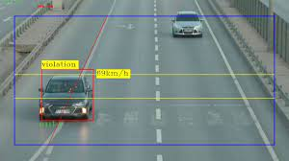
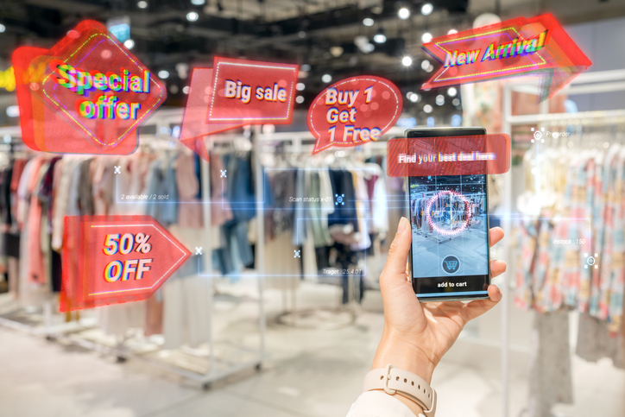
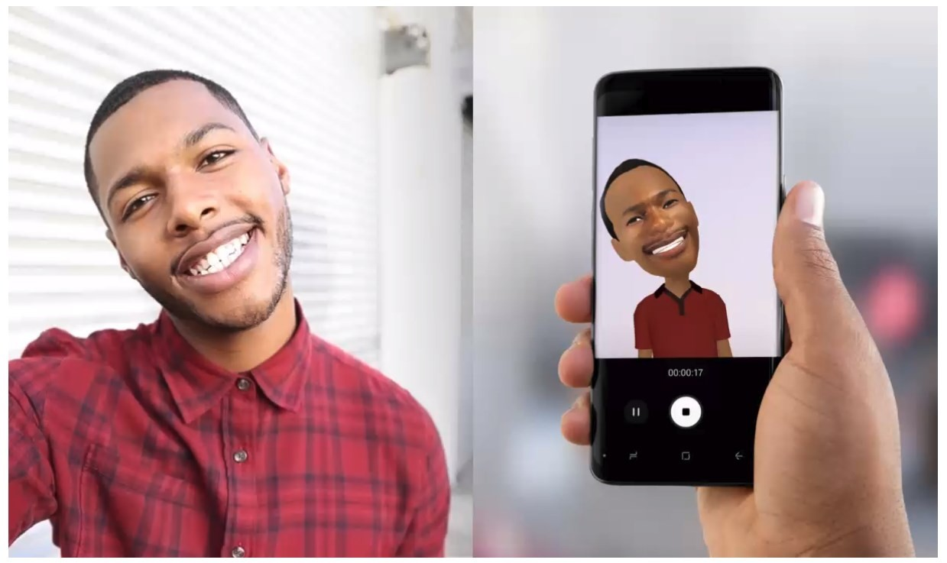

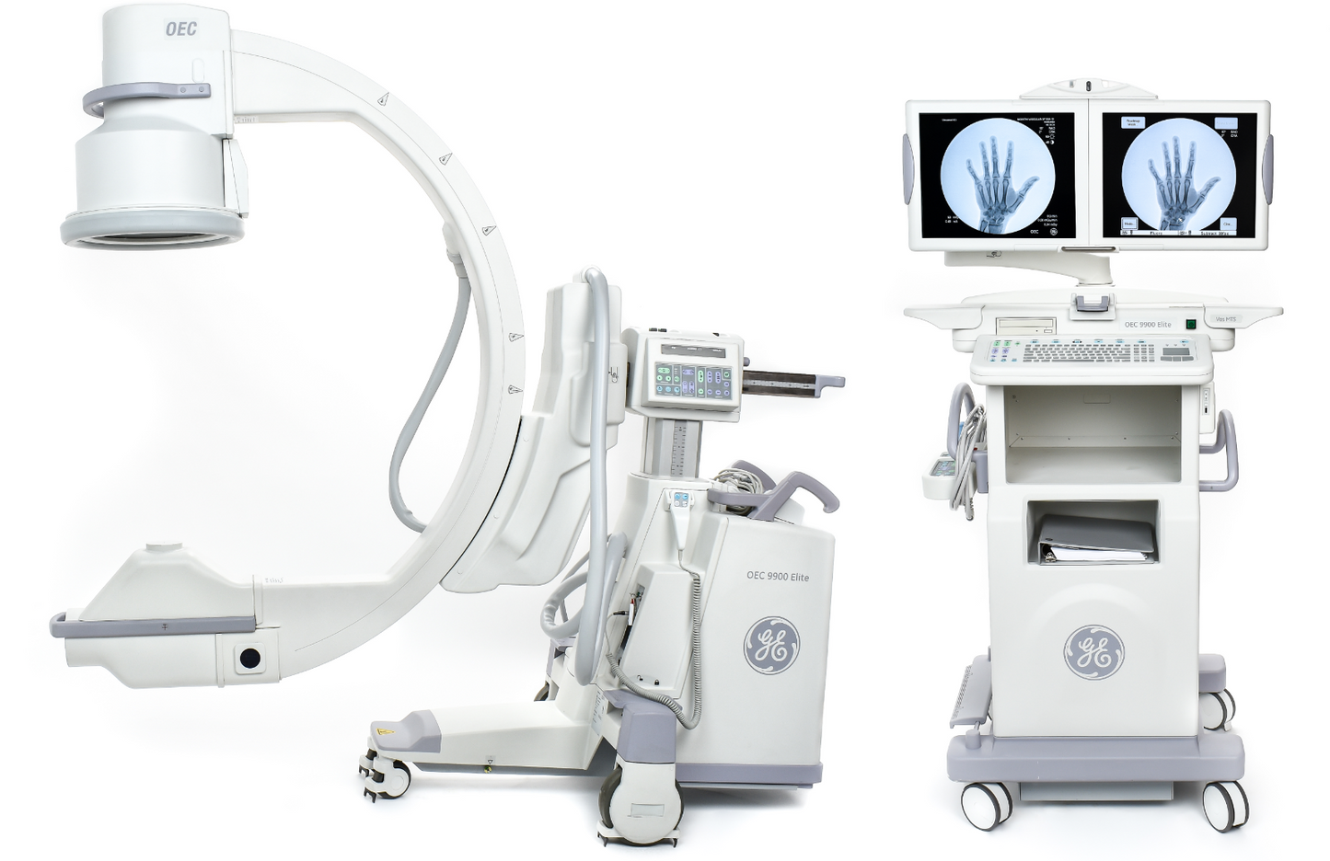
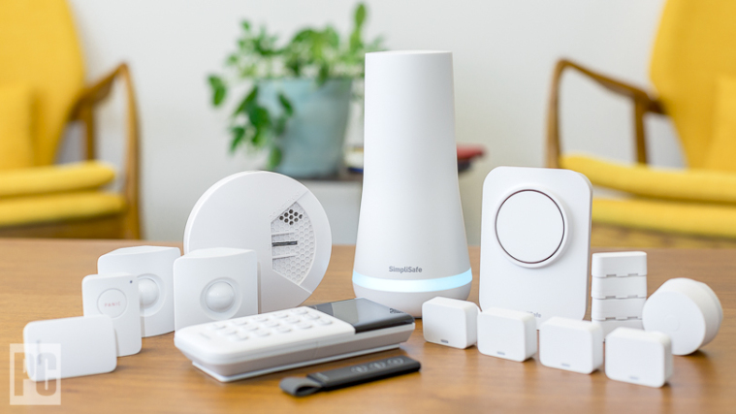
Intelligent edge applications
Vehicle detection
Immersive online shopping
AR emoji
AR & VR devices
Remote healthcare devices
Smart Home Devices
Notes:
Recent years have witnessed various intelligent edge applications (like healthcare, entertainment, and smart home applications) becoming integral components of our daily lives.

Slide 3
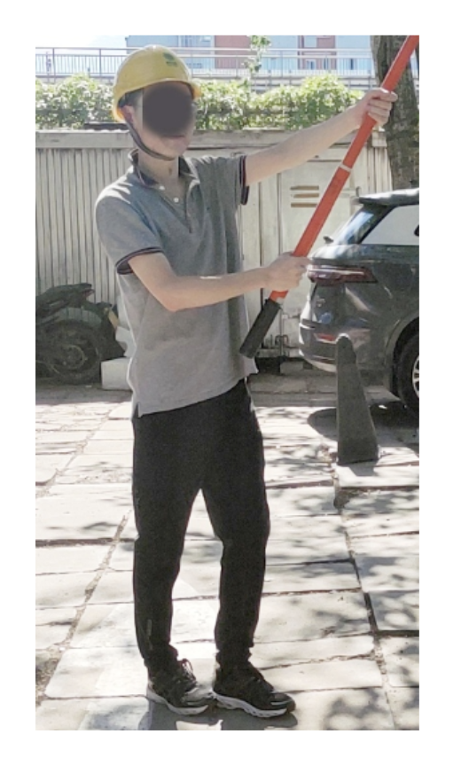




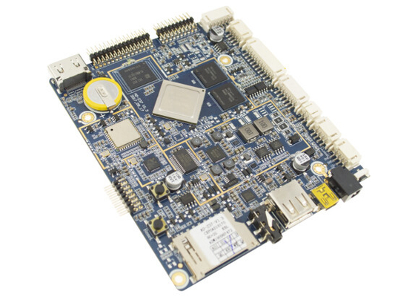


Problem
DNN services
Person Detection
Pose estimation
low response latency
protect privacy
Gloves Detection
Helmet Detection
Low throughput
problem
Helmet/gloves wearing detection
Notes:
Typically, to ensure a seamless user experience, Such edge applications often rely on a set of DNN services.
For instance, violation operation detection, which determines whether operators in a state grid corporation wear wear valid helmets and gloves during operations, necessitates at least four DNN inference services: human detection, pose estimation, and helmet/gloves classification.
Recently, there exists a trend that deploying DNN services to edge devices, which can provide low response latency and protect privacy.
However, considering the edge devices are designed for low-power scenario and limited compute capacity, deploying DNN services on edge devices suffer from low throughput problem.

Slide 4
Opportunities
An edge device contains multiple heterogeneous processors
Type | Processors
CPU | 1- 3.0 GHz X2 + 3- 2.5 GHz Cortex A710 + 4- 1.8GHz Cortex-A510
GPU | Adreno 650
Accelerator | Hexagon 698 DSP
IP Cameras
Type | Processors
CPU | 12-core Arm Cortex-A78AE
GPU | Ampere 1024 CUDA core + 32 Tensor Cores
Accelerator | Deep learning accelerator (DLA)
IoT devices
Notes:
To tackle this issue, we have observed that various types of heterogeneous processors on edge devices.
For instance, Snapdragon 865 SoC contains CPU, GPU, Hexagon 698 DSP, while Jetson Orin comprises of CPU, Ampere GPU, and deep learning accelerator.
(click1)
However, we have found that they have not been utilized fully.

Slide 5
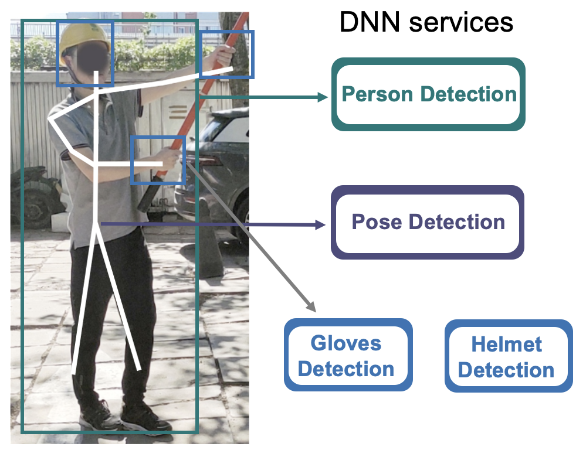


Motivation
Efficient heterogeneous processors
Edge device
CPU
GPU
DSP
DLA
Can we offload the DNN services to the heterogeneous processors?
Notes:
So here we have so many DNN services and efficient heterogeneous processors like DSP and DLA.
(click1)
The question is that Can we offload the DNN services to the heterogeneous processors to improve the throughput efficiency?

Slide 6
Challenge#1: High complexity in scheduling design
DNN-inference-service-to-processor affinity and hardware support
DNN Service | DNN Model | Latency |  |  | Utilization
 |  | CPU | GPU | DSP | CPU | GPU | DSP
Person detection | SSD-quant | 112.1 ms | 79.9 ms | 103.1 ms | 361% | 56% | 77%
Pose estimation | CenterNet | 22.9 ms | 31.7 ms | - | 287% | 30% | -
Helmet detection | SSD-Helmet-quant | 25.6 ms | 8.4 ms | 5.9 ms | 195% | 58% | 85%
Gloves detection | Pole-gloves | 6.7 ms | 3.2 ms | - | 198% | 34% | -
Text recognition | OCR-recognition | 30.8 ms | 38.1 ms | - | 295% | 35% | -
No one-size-fits-all processor as cloud GPU.
Notes:
We have found two challenges.
The first challenge is High complexity in scheduling design.
First, Our preliminary offline experiments have yielded a crucial insight: an obvious service-processor affinity exists.
In other words, there is no one-size-fits-all processor on devices to which all services can be indiscriminately scheduled.
（click1）
For instance, the person detection service achieves its optimal performance on the GPU,
(click2)
while the pose estimation service exhibits superior execution on the CPU.
This affinity arises from the highly varied characteristics inherent in modern DNNs, including network architecture, layer shapes, and input sizes.
(click3)
Additionally, certain processors, such as the Hexagon DSP, lack support for floating-point arithmetic, thereby rendering services reliant on quantized models, like helmet detection.

Slide 7


Challenge#1: High complexity in scheduling design
Parallel execution
DNN service 1
DNN service 2
❌ Fail scheduling
Not all processors support parallel execution
DSP
Optimal performance: Not exceed hardware capacity
DNN service 1
Needing 2 cores
❌ contention
Needing 3 cores
4 cores
DNN service 2
Notes:
The second factor is that not all processors support parallel execution.
Edge CPUs typically support parallel execution, whereas edge NPUs/GPUs do not.
Besides, different processors boast distinct capabilities when concurrently executing multiple services. For instance, the CPU can achieve a maximum utilization of 400\% in the Snapdragon 865 SoC. To ensure optimal performance, the resource consumption by parallel execution on the same processor must not exceed the processor's capacity.
（click1）
Batch execution is another common strategy to group several identical services for simultaneous execution.
This approach yields a longer instruction queue and greater instruction parallelism, mitigating stalls in memory access.
(click3)
Consequently, batch execution can boost processor utilization and throughput while simultaneously introducing longer per-service latency.

Slide 8
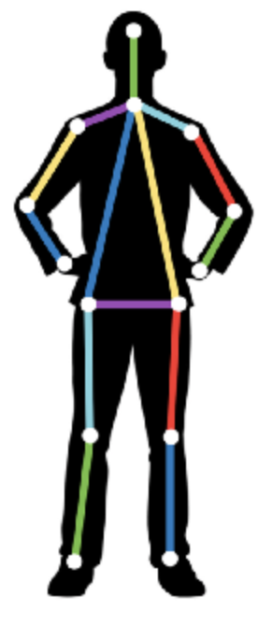
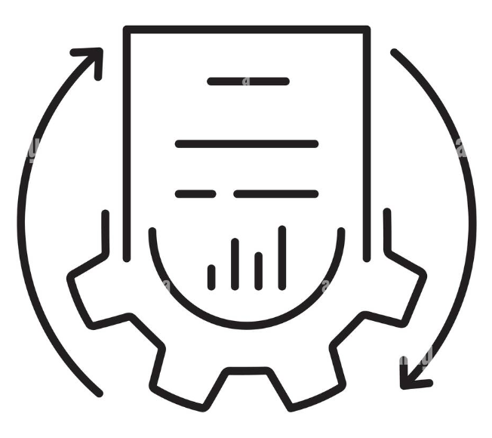
Challenge#1: High complexity in scheduling design
Batch execution: higher throughput with longer latency
…
Input merging
DNN services
Results
Batch size | Latency (ms) | Throughput (DNN/s)
1 | 12 | 83.3
2 | 15 | 133.3
4 | 20 | 200.0
8 | 30 | 266.7
8x batch size
2.5x latency delay
3.2x throughput
enhancement
Notes:
Batch execution is another common strategy to group several identical services for simultaneous execution.
This approach yields a longer instruction queue and greater instruction parallelism, mitigating stalls in memory access.
(click3)
Consequently, as our preliminary experiments show, batch execution can boost processor utilization and throughput while simultaneously introducing longer per-service latency.

Slide 9
Challenge#1: High complexity in scheduling design
Summary and implications
Edge device
DNN service-to-processor affinity
Hardware support
Parallel execution
Batch execution
Jointly
considering
CPU
GPU
DSP
DLA
Existing work
Online heuristic algorithm: Low performance
Offline algorithm: No dynamic support
Notes:
To sum up, Niagara should jointly optimize DNN-inference-service-to-processor affinity, enabling parallel execution, and efficiently batching inputs together.
(click1)
To solve this problem, existing work either depends on online heuristic algorithms which achieve low performance or uses offline algorithm that does not support dynamic services.

Slide 10
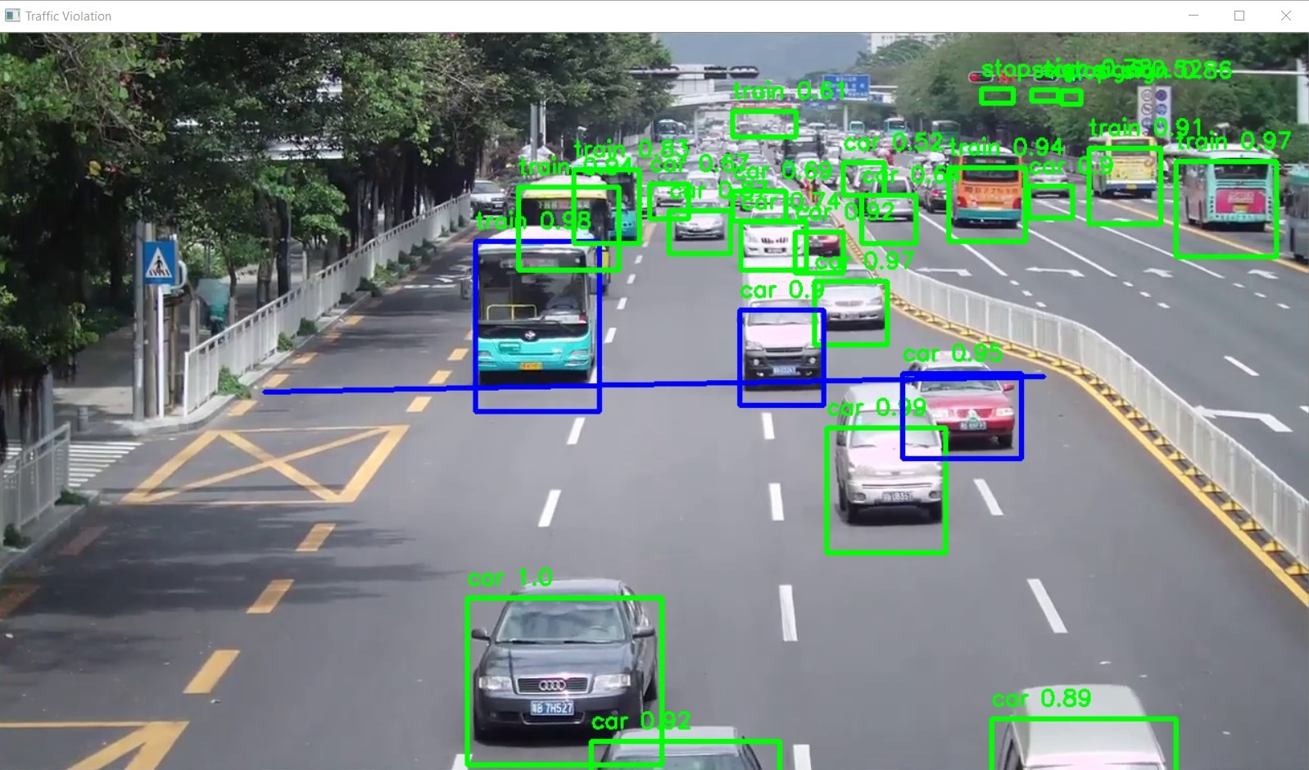
Challenge#2: Unknown and mutative service workload
Unknown service workload limits scheduling space
Processing system
Existing work
Lightweight methods: only one request service graph
Complex methods: high predicting overhead
Notes:
the second challenge is xxx.
services depend on future input, which is only accessible when the corresponding DNN inference service (e.g., car detection) has been executed.
Such circumstance leads to a dilemma of limited scheduling space.
(click1)
Although existing work tries to solve this problem, the Lightweight methods usually can only predict the next request service graph, while the complex methods suffer from the high predicting overhead.

Slide 11
Summary of challenges
DNN services
#1: High complexity in scheduling design
Efficient heterogeneous processors
Person Detection
Edge device
Pose Detection
CPU
GPU
DSP
DLA
Gloves Detection
Helmet Detection
#2: Unknown and mutative service requests
Notes:
To sum up, when offloading the DNN services to the edge heterogeneous processors,
Niagara faces the challenges of High complexity in scheduling design and Unknown and mutative service requests.

Slide 12
Niagara
DNN services
#1: offline optimization + online scheduling
Efficient heterogeneous processors
Person Detection
Edge device
Niagara
Pose Detection
CPU
GPU
DSP
DLA
Gloves Detection
Helmet Detection
#2: decouple the prediction of the service graph and coming requests
Notes:
To solve this problem, we propose Niagara.
The first scheduling engine for DNN services on heterogeneous processors is motivated by two key insights.
The first one is that we use a combination of offline optimization and online adaptation to solve the high scheduling complexity problem.
Besides, we propose to decouple the prediction of the service graph and coming requests to predict multiple request service graphs.

Slide 13
Niagara
DNN services
#1: offline optimization + online scheduling
Efficient heterogeneous processors
Person Detection
Edge device
Niagara
Pose Detection
CPU
GPU
DSP
DLA
Gloves Detection
Helmet Detection
#2: decouple the prediction of the service graph and coming requests
Notes:
For the first technique

Slide 14
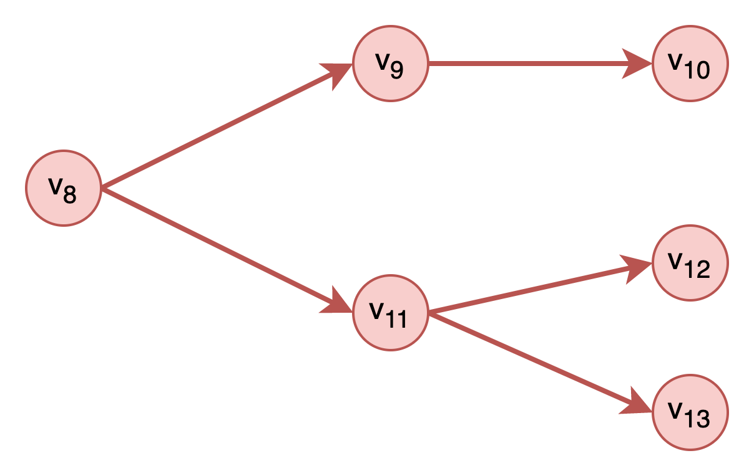

Offline optimization and online scheduling
Key idea
Abstract
Online service graphs
Offline service graph templates
Heterogenous processors
Template-based strategy matcher
Scheduling Problem
CPU
GPU
DSP
DLA
Deploy
Scheduling strategies
Notes:
our key idea is that DNN service request patterns can be abstracted into several typical \textbf{service graph templates}.
Based on that, \sys can optimize the service-to-processor scheduling strategy for each service graph template offline, deploy the strategy on the edge devices. When a new input request comes in, the Template-based strategy matcher can match the appropriate strategy to service graph online, and adapt the strategy to dispatch the DNN service tasks to Heterogenous processors.

Slide 15
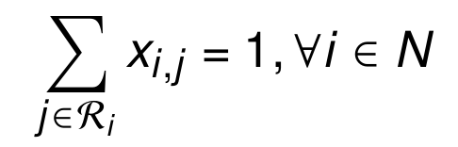
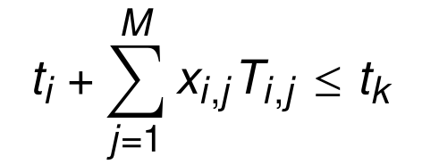
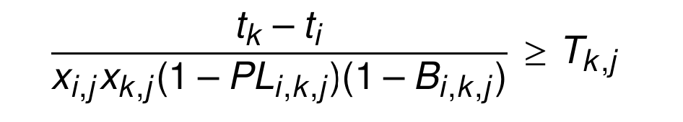
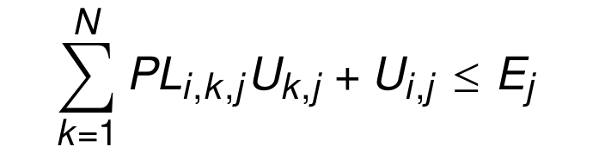
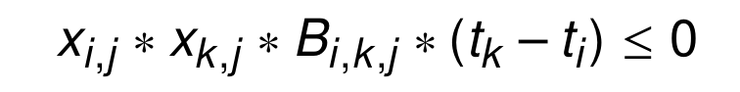
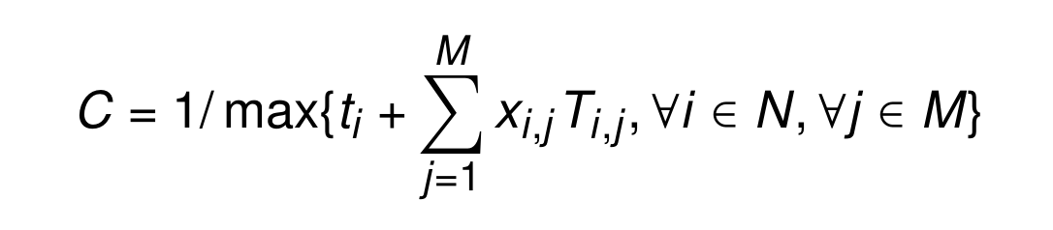
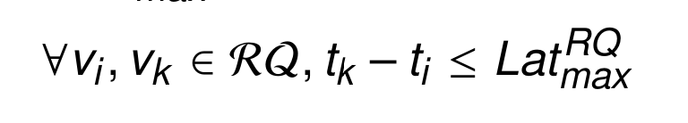
Offline optimization
Offline scheduling problem
Decision variables
Objective: maximum throughput
max C s.t. Eq. (1)-(7)
(1)
Variable | Description
Placement | Service-to-processor choice
Batch | Control batch execution
Parallel | Control parallel execution
(2)
(3)
(4)
(5)
(6)
(7)
Notes:
During the offline stage, We first define the offline scheduling problem, including three decision variables, for Service-to-processor choice, Controlling batch execution, and controlling parallel execution.
The objective is to obtain the maximum throughput under the response requirement.
Such a problem can be solved by the GUROBI

Slide 16
Offline optimization
Offline scheduling problem
Decision variables
Objective: maximum throughput
max C s.t. Eq. (1)-(7)
(1)
Variable | Description
Placement | Service-to-processor choice
Batch | Control batch execution
Parallel | Control parallel execution
(2)
GUROBI solver: Less than 10% optimality loss
(3)
(4)
(5)
(6)
(7)
Notes:
Such a problem can be solved by the GUROBI solver.
Our evaluation shows that only less than 10% optimality loss occurs.

Slide 17
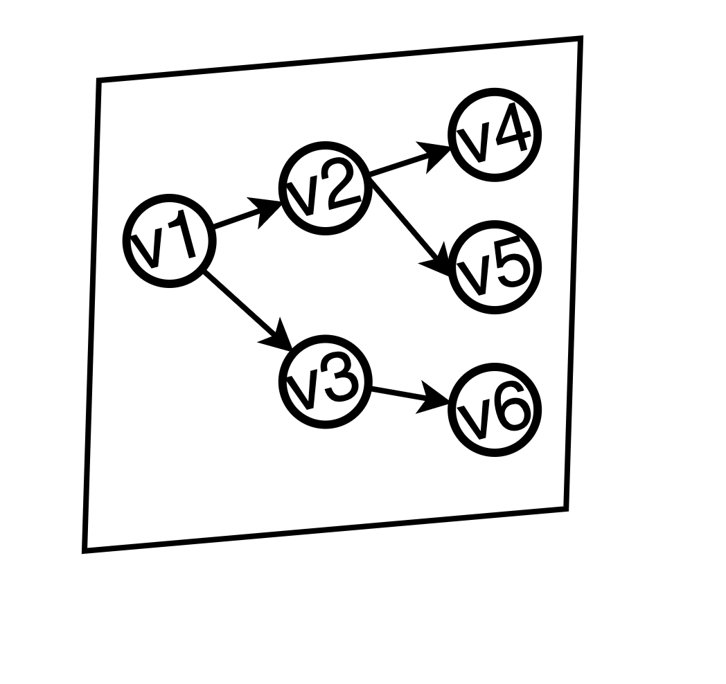
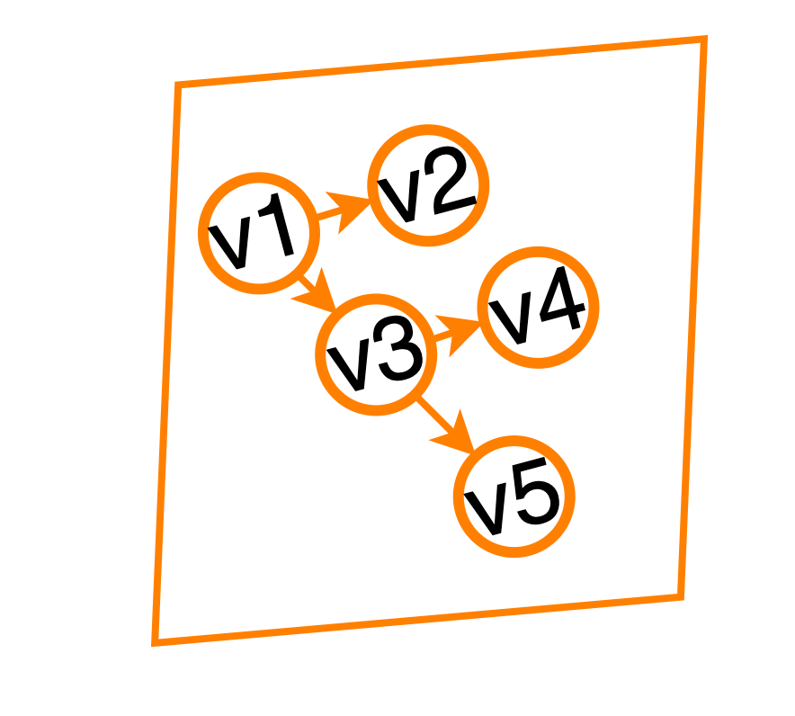

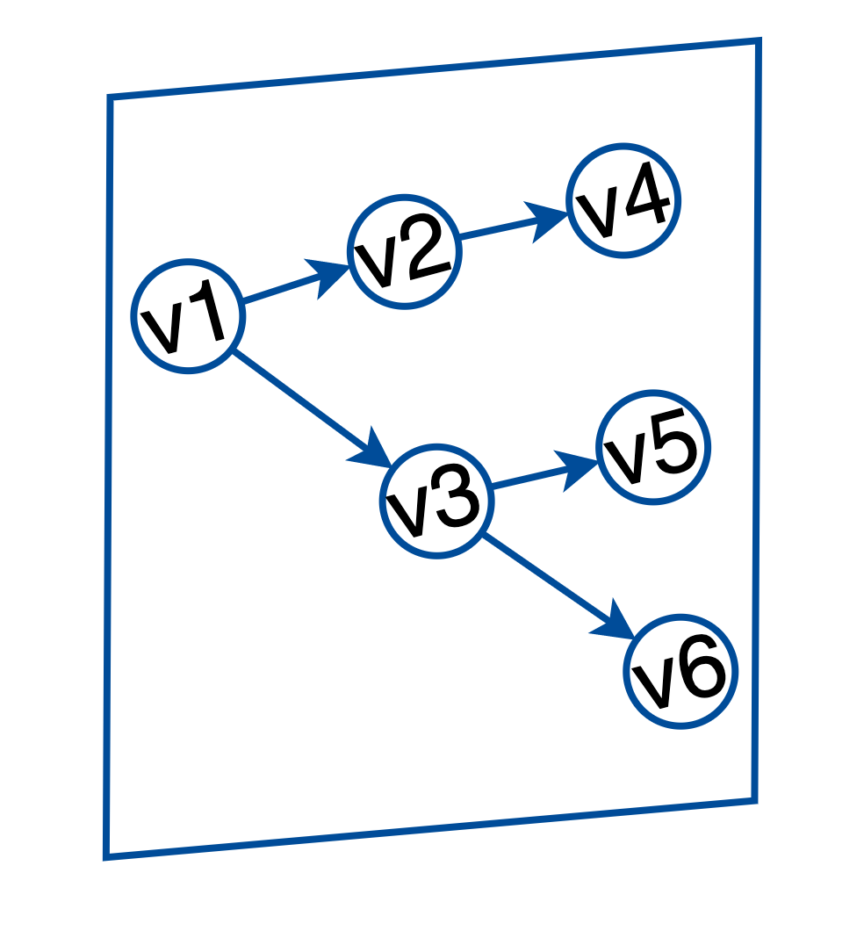
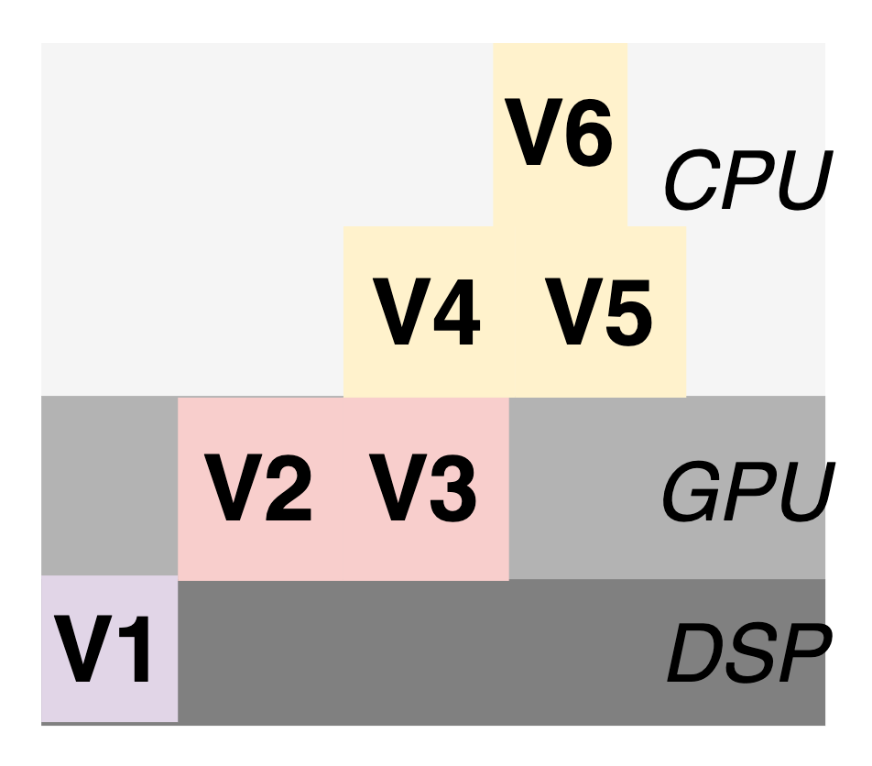
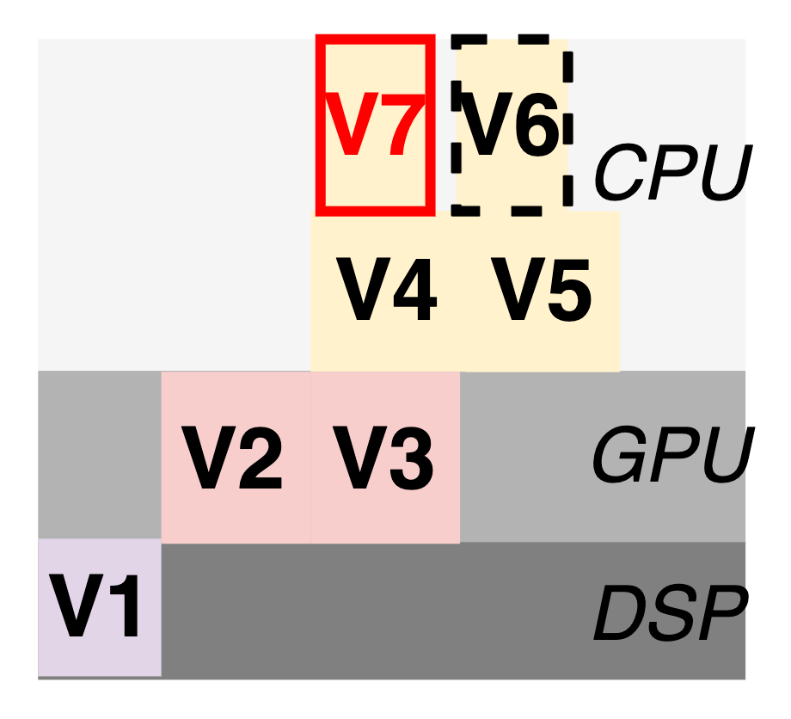
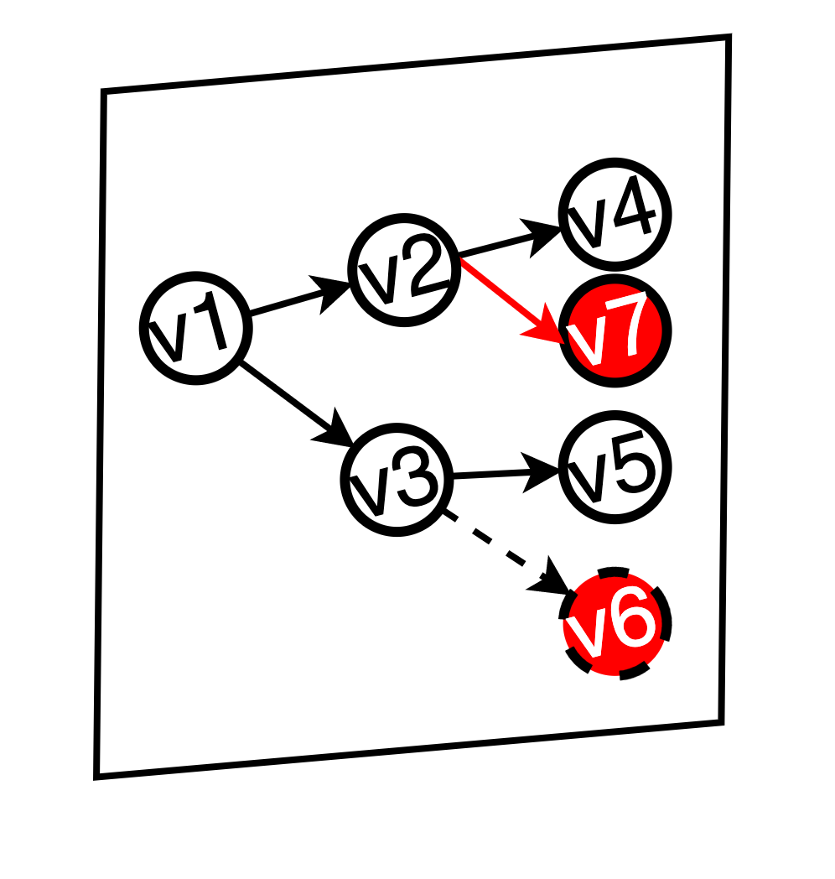
Online scheduling
Template-based strategy matcher
Current service graph template
Euclidean distance
Online service graph
>=0.5
Adapt
Select
Cached service graph templates and strategies
Notes:
After having so many feasible strategies, the online scheduler will adapt them to online environment and dispatch them.
First, \sys utilizes the Euclidean distance metric \cite{danielsson1980euclidean} to quantify the disparity between the online service graph (derived from the current image) and the service graph template
Then, If the distance exceeds the threshold, \sys discontinues the current scheduling strategy and selects a new one that closely matches the online service graph.
Recognizing that the online service graph may not always align perfectly with the template, \sys incorporates an adaptation mechanism to accommodate unexpected variations.
It first endeavors to match online graph services with template services as closely as possible.
Some nodes such as v6 and v7 will not match.
To solve this problem, \sys first selects the first unmatching newly added service (e.g., v7) and places it within the earliest available idle period.
services like v6 will be eliminated and Other services can begin as early as possible when constraints satisfied.

Slide 18
Niagara
DNN services
#1: offline optimization + online scheduling
Efficient heterogeneous processors
Person Detection
Edge device
Niagara
Pose Detection
CPU
GPU
DSP
DLA
Gloves Detection
Helmet Detection
#2: decouple the prediction of the service graph and coming requests
Notes:
For the second technique,

Slide 19


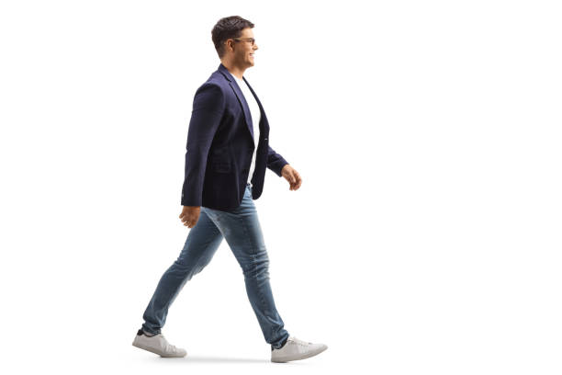


Dynamic input predictor
The service graph tends to be more stable than the content.
Different directions
Same service graph
Different backgrounds
Notes:
To solve this problem,
We have found that the service graph tends to be more stable than the content, providing an opportunity for prediction.
For instance, a person in different directions or under different backgrounds will trigger the same graph.

Slide 20
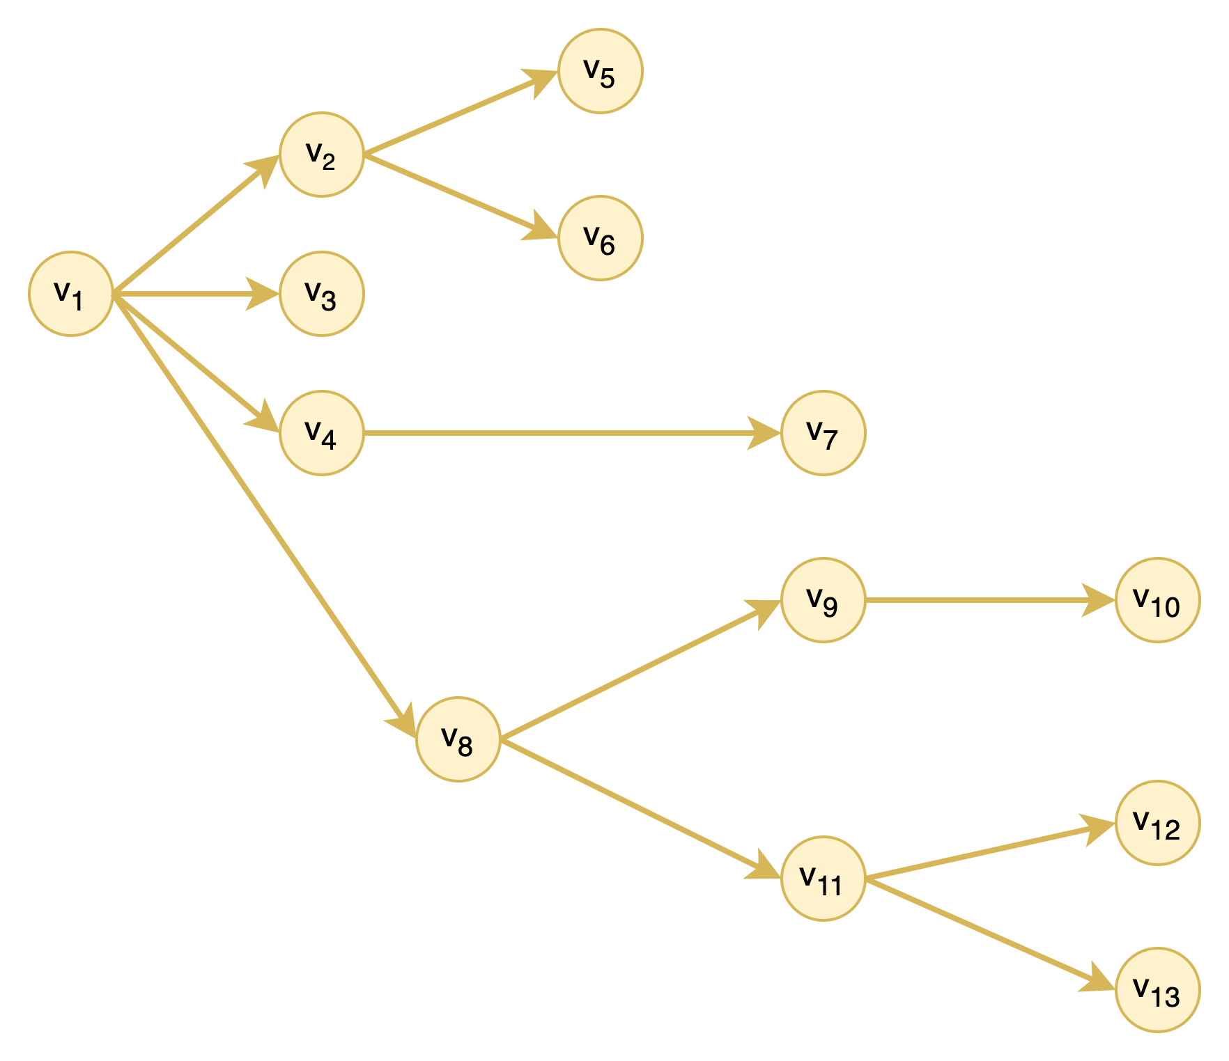

Dynamic input predictor
Decouple the prediction of the service graph and coming requests
Service graph
Decouple
Merge
…
Predictor
…
Number of the requests having the same service graph
Multiple requests’ service graph
Notes:
To that end, when predicting multiple requests’ service graph, we can decouple the service graph and the coming request.
Specifically, our predictor first predicts the next request service graph as most works do.
Besides, it predicts how many requests have the same service graph.
(click1)
After obtaining the service graph and the request number, Niagara will merge them to build a new Multiple requests’ service graph.

Slide 21
Evaluation: methodology
Settings
8 service combinations + 11 DNN services + 3 real-world video stream
3 commodity devices
Real-deployment
Baselines
3 industry baselines
TFLite
Greedy algorithm
FIFO algorithm
2 SOTA research baselines
ODT-SC algorithm^{[1]}
LSTM-Niagara algorithm
[1] Zhao G, Xu H, Zhao Y, et al. Offloading tasks with dependency and service caching in mobile edge computing[J]. IEEE Transactions on Parallel and Distributed Systems, 2021, 32(11): 2777-2792.
Notes:
We implement an end-to-end prototype of \sys on the Android OS.
Our evaluation comprises 8 types of \service combinations, including 11 distinct DNN services, 3 real-world video stream requests, and 3 different edge devices.
We tested our system by three commodity devices. We also deployed them on the real environment.
Besides, We have 5 baselines, including 3 three industrial baseline: TFLite, the vanella runtime, greed algorithm and 2 stoa research baselines ODT-SC algorithm and LSTM-niagara algorithm.
The ODT-SC algorithm is designed to optimize the scheduling of a DNN service graph on heterogeneous edge nodes. We modify it to the heterogeneous processors scenario.

Slide 22
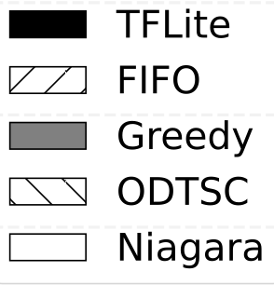
Evaluation: throughput
Different service combinations
Niagara can achieve a throughput of at least 10 FPS (minimum real-time requirement) in any environment
3.0x
1.8x
2.0x
1.9x
Throughput (FPS)
10FPS
Notes:
Overall, \sys achieves a 3.0$\times$, 1.9$\times$, 2.0$\times$, and 1.8$\times$ throughput improvement compared with TFLite, FIFO, Greedy, and ODTSC on average, respectively.
That is because our strategy jointly considers batch and parallel execution with \service-to-hardware selection.
More important, as the scenario is more complex, the benefits of \sys are more.

Slide 23
Evaluation: throughput
Different devices
More powerful processors, more benefits
3.5x 2.7x 2.6x 1.8x
Throughput (FPS)
4.6x 1.9x 1.5x 1.5x
Notes:
We also evaluate \sys on different edge devices.
For instance, \sys's throughput is 10 FPS on Snapdragon 855 SoC development board, while 5.46 FPS, 3.78 FPS, 3.74 FPS, and 2.84 FPS under ODT-SC CP, Greedy, FIFO, and TFLite baselines, respectively
Usually the higher performance processors can achieve a higher speedup.

Slide 24
Evaluation: throughput
Real deployment
Efficiently and stably improving throughput in real-world environments
Up to 2.33x
At least 1.26x
Throughput (FPS)
Stable environment
Frequently changing environment
Notes:
We have successfully deployed \sys in an electric station and conducted evaluation on a real 20-minite video.
During the stable environment, \sys achieves throughput improvements by 2.33x while only 1.26x for frequently changing scenario.

Slide 25

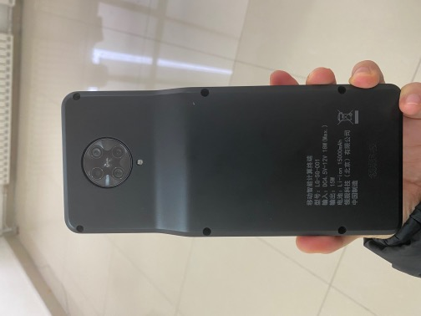

Real deployment
Custom-made IP Cameras
State Grid corporation of China
Real execution
6-month pilot run with18,000 maintenance jobs
zero accidents
Save traditional human-based supervision
Thousands of substation in the future
Notes:
Lastly, I'd like to share our real deployment results.
The figure shows a custom-made IP camera on a Snapdragon 865 development board and the real execution deployed in several power supply substations that serve millions of people in a large Chinese city.
(click1)
This deployment aims to enhance the safety of operators working on electric switching operations.
During the 6-month pilot run, which included over 18,000 maintenance jobs, zero accidents were reported, representing a significant improvement over traditional human-based supervision.
In the near future, \sys will be extended to thousands of substations, showcasing how edge intelligence can contribute to society.

Slide 26
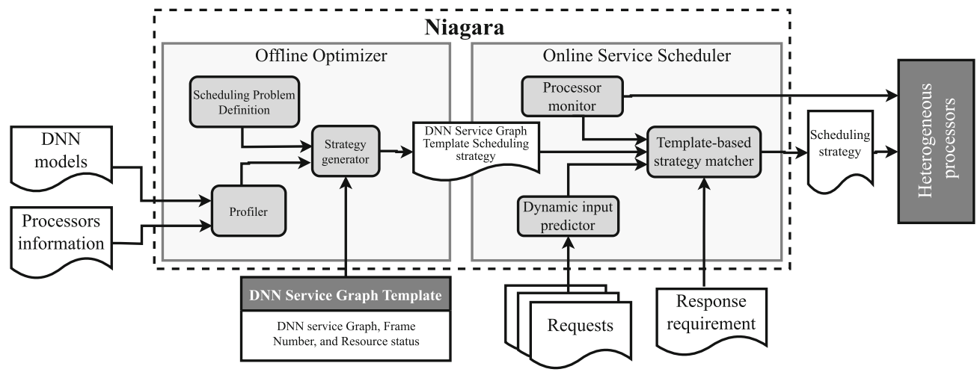




Take-away
First scheduling engine for DNN services on edge heterogeneous processors
Offline optimization + online scheduling
Real deployment and saving traditional human-based supervision
Niagara
xudaliang@pku.edu.cn
https://daliangxu.github.io/
More about our affordable AI systems: http://www.liuxuanzhe.com
Notes:
In conclusion,
We have proposed The first scheduling engine for DNN inference services on edge devices using heterogeneous processors.
It exploits Offline optimization and online scheduling methods to achieve both high throughput and low scheduling overhead.
We have deployed \sys to real power station to show its effectiveness and save traditional human-based supervision.
Thanks for your listening.
If you have any questions about Niagara, please ask Daliang Xu via this e-mail address.
If you are interested in our affordable AI systems, please refer to this web site for more details.

